Slide 1
Azure AI Ecosystem Technical Deep Dive –Day 1
Sashank Pappu
Azure Data & AI Specialist

Slide 2


Sashank Pappu
Azure Data & AI Specialist.
Certified from MIT on ‘Advanced Analytics and Big Data Challenges’. Technology Enthusiast and Data Specialist. Certified Designer in Computer Vision
• Microsoft Certified Power BI Developer. • Microsoft Certified Azure Machine Learning Developer from Microsoft Virtual Academy • Certified on Practical Data Analytics with Microsoft Cortana Intelligence Suite.
9+ years of total experience as Data Specialist and Data Engineer.
Certifications
Experience
Currently working as Independent Consultant on Azure Data & AI and Enterprise Trainer on Azure Data Analytics , Cortana Intelligence Suite and Cognitive Sciences
Expert facilitator and corporate behavioral trainer with 5 years of experience in designing programs, content development , Data Analytics and Machine Learning.
Role
Training
Sri Nag Sashank
You can see me on – Sashankpappu.com

Slide 3
Day 1 - AI
Azure AI Ecosystem
Azure AML Studio
Azure ML Services
Azure AutoML

Slide 4
Day 2 - AI
Azure Databricks
Azure Machine Learning Services
Deployment into Containers
Use case on Custom AI & Cognitive Services

Slide 5


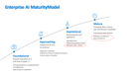
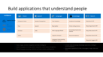
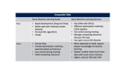

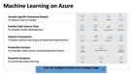
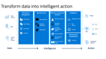

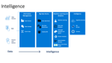
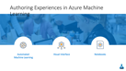
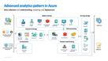
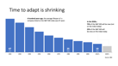
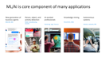
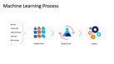

Slide 6
AGENDA
Overview of Machine Learning Offerings
10-11 : AML Studio Intro & Hands on Deployment
11-11:15: BREAK!!!
11:15-1 : AML Studio - Labs Hyper Tuning
1-2 : LUNCH
2-3:15 : Auto ML Intro
3:15-5 : Hands on Azure AutoML

Slide 7

Insights is a journey
Insight
What happened?
Why did it happen?
What will happen?
What should I do?
Reports
Interactive
Dashboards
Predictive
Models
Recommendations
& Automation
Notes:
While data is pervasive, actionable intelligence from data is elusive. We understand that customers want to transform data to intelligent action and reinvent their business processes. To do this they need to more easily analyze massive amounts of data – so they can move from seeing “what happened” and understanding “why it happened” to predicting “what will happen” and ultimately, knowing “what should I do”. Only then can they create the intelligent enterprise and accelerate digital transformation.
Put another way, the journey to greater insight involves moving from “forensic” or “descriptive” analytics – use of historic measurement to describe what happened and why – to more advanced analytics that become “predictive” and eventually “prescriptive”.
This journey is a natural evolution as an organization leverages data more thoroughly. We think about it in 4 steps:
Step 1: What happened?
Utilize descriptive analytics to understand what happened
Step 2: Why did it happen?
Incorporate diagnostic analytics for a better understanding of why certain things happened in the past, making it possible to better identify root causes
Step 3: What will happen?
Expand into predictive analytics: With sufficiently detailed historical data and the rigorous application of statistical methods including machine learning, we can now predict a variety of events and effects that could not accurately be forecast in the past.
Step 4: What should I do?
Use prescriptive analytics for foresight: Foresight is the holy grail of analytics. By analyzing a set of reactions, we can not only predict what will happen, but how various responses will fare, given individual conditions, people, etc. It requires not only that we predict, but that we measure the individualized results of actions taken in the past, like medical treatments for particular patient cohorts, and then measure the effectiveness of past actions in prescribing how to react in the future. We can then automate action based on the prescriptive analytics, delivering business value directly in the flow of daily business activities.

Slide 8
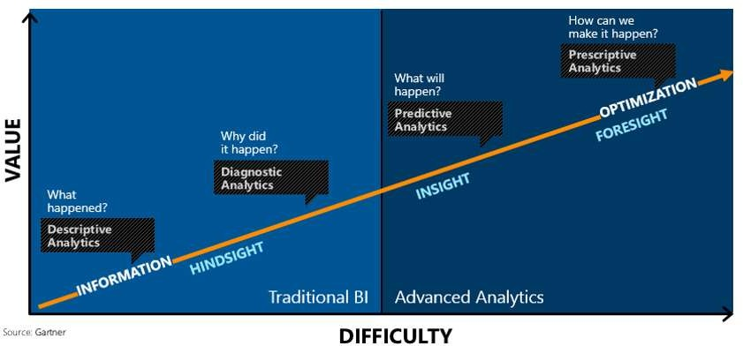

Slide 9




Enterprise AI Maturity Model
Mature
Emerging data science
and operational capability
Understands model lifecycle
Building a foundational data architecture
Aspirational
Experimented and applied AI
High digitization
Desires new business models Achieved a data culture
Approaching
Hopeful on AI and its promise
Digitization underway
Looking to increase or optimize processes Cautious about disruption
Foundational
Questioning what AI is and how to apply it
Wrong expectations or disappointment Low digitization
Basic analytical capabilities

Slide 10
Convergence accelerates digital transformation
Cloud
Data
Intelligence
Notes:
Three key trends are converging to accelerate digital transformation:
First, the cloud provides new and powerful ways to economically and reliably capture and persist the vast new data resources.
Second, thanks to the exponential proliferation of small, inexpensive chips and processors, computers are as ubiquitous as the people who use them. This is increasing the availability of vast and detailed data about products, businesses, market conditions, devices, and consumers and is creating new opportunities for businesses to tailor their strategy to market demand.
Finally, machines are everywhere, constantly creating, collecting and making sense of the data in our midst. With the magic of machine learning, along with the limitless computing power of the cloud, this data is giving rise to intelligence that is augmenting human capabilities in exciting new ways. This marks a unique point in history…an opportunity for organizations to automate and innovate quickly to increase their speed of business.

Slide 11
Time to adapt is shrinking
A hundred years ago, the average lifespan of a company listed on the S&P 500 index was 67 years
In the 2020s…
75% of the S&P 500 will be new (not on the index today)
25% of the S&P 500 will
be ones on the index today
Source: BBC
Notes:
Compared to the past, what’s unique about the disruption happening today is its pace. During past revolutions, firms had many years, even decades, to adapt. Today, that is no longer the case. One indicator of just how fast the landscape is changing is the longevity of companies on the S&P 500, an index of leading US companies.
A hundred years ago, the average lifespan of a company listed on the S&P 500 was 67 years. Today, that average lifespan has decreased to just 15 years.
Experts predict that in the next decade, only 25% of the companies currently listed on the S&P 500 will remain there, and the other 75% will be replaced by new companies.
The bottom line is, today’s organizations must adapt quickly to change, using new technologies that fuel competitive advantage, or risk getting left behind.
-------------------------------------------
Statistics source:
BBC, 2012, quoting Richard Foster - http://www.bbc.com/news/business-16611040
"The average lifespan of a company listed in the S&P 500 index of leading US companies has decreased by more than 50 years in the last century, from 67 years in the 1920s to just 15 years today, according to Professor Richard Foster from Yale University. Professor Foster estimates that by 2020, more than three-quarters of the S&P 500 will be companies that we have not heard of yet."

Slide 12



Information Management
Information Management
Data Sources
Data Factory
Apps
Data Catalog
Event/IoT Hubs
Sensors and devices
Data
Notes:
T: Information Management includes Data Factory, Data Catalog, and Event Hubs.

Slide 13
Big Data Stores
Information Management
Big Data Stores
Data Sources
Data Factory
Data Lake Store
Data Catalog
SQL Data
Warehouse
Apps
Event Hubs
{ }
Cosmos DB
Sensors and devices
Data
Notes:
T: Azure provides a variety of storage options, including Blobs. Here we’ll dive into the two main storage options with Cortana Intelligence, starting with Data Lake Store.

Slide 14

Machine Learning and Analytics
Information Management
Big Data Stores
Machine Learning and Analytics
Data Sources
Data Factory
Data Lake Store
Machine Learning
Data Catalog
SQL Data
Warehouse
Data Lake Analytics
Apps
HDInsight
(Hadoop and Spark)
Event Hubs
{ }
Cosmos DB
Stream Analytics
Sensors and devices
Azure Analysis Services
Azure Time Series Insight
Data
Intelligence
Notes:
T: Advanced analytics services are where data starts turning into insight that drives intelligent action.

Slide 15
Intelligence
Information Management
Big Data Stores
Machine Learning and Analytics
Intelligence
Data Sources
Data Factory
Data Lake Store
Machine Learning
Cognitive Services
Data Catalog
SQL Data
Warehouse
Data Lake Analytics
Bot Service
Apps
HDInsight
(Hadoop and Spark)
Event Hubs
{ }
Cosmos DB
Cortana
Stream Analytics
Sensors and devices
Azure Analysis Services
Azure Time Series Insight
Data
Intelligence
Notes:
T: Our intelligence capabilities fall into three areas – Cognitive Services, Bot Framework and Cortana.

Slide 16


Build applications that understand people
Intelligence
Vision
Speech
Language
Knowledge
Search
Cognitive Services
Computer Vision
Speaker Recognition
Text Analytics
Academic
Bing Web Search API
Content Moderator
Bing Speech
Bing Spell Check
Entity Linking
Bing Image Search API
Bot Service
Face
Custom Speech Service
Web Language Model
Knowledge Exploration
Bing Video Search API
Cortana
Emotion
Linguistic Analysis
Recommendations
Bing News Search API
Video
Language Understanding
QnA Maker
Bing Auto Suggest API
Translator
Faces, images, emotion recognition and video intelligence
Spoken language processing, speaker recognition, custom speech recognition
Natural language processing, sentiment and topics analysis, spelling errors
Complex tasks processing, knowledge exploration, intelligent recommendations
Bing engine capabilities for Web, Autosuggest, Image, Video and News
Notes:
What’s incredibly unique is the intelligence capabilities Cortana Intelligence offers, building on years of Microsoft research and innovation. These capabilities enable our customers to build intelligent systems and agents that can augment their organizational capabilities. For example, organizations can interact with customers and stakeholders in new ways and infer intent with vision, face, speech, text and sentiment analysis to customize responses and drive appropriate actions.
Microsoft Cognitive Services, a set of cloud services, APIs and SDKs that enable organizations to build intelligent systems that can see, hear, interpret and understand the world around you and makes all applications more intelligent, engaging and discoverable. Cognitive Services expands the existing perceptual intelligence capabilities like Vision, Speech, Text and Face detection to include new cognitive capabilities such as Emotion and customized Language Understanding. What we showcased with www.how-old.net is one example of what is possible.
T: Next, Bot Service.

Slide 17

Transform data into intelligent action
Information Management
Big Data Stores
Machine Learning and Analytics
Intelligence
Data Sources
People
Data Factory
Data Lake Store
Machine Learning
Cognitive Services
Data Catalog
SQL Data
Warehouse
Data Lake Analytics
Bot Service
Apps
Web
Event Hubs
HDInsight
(Hadoop and Spark)
{ }
Cosmos DB
Cortana
Mobile
Apps
IoT Hubs
Stream Analytics
Dashboards & Visualizations
Bots
Sensors and devices
Azure Analysis Services
Azure Time Series Insight
Power BI
Automated Systems
Data
Intelligence
Action
Notes:
T: Cortana Intelligence provides everything you need to transform your organization’s data into intelligent action. Next, let’s take a look at another demo.

Slide 18
AI is new SQL
Trends and Advancements in space of Computer Vision and NLP

Slide 19
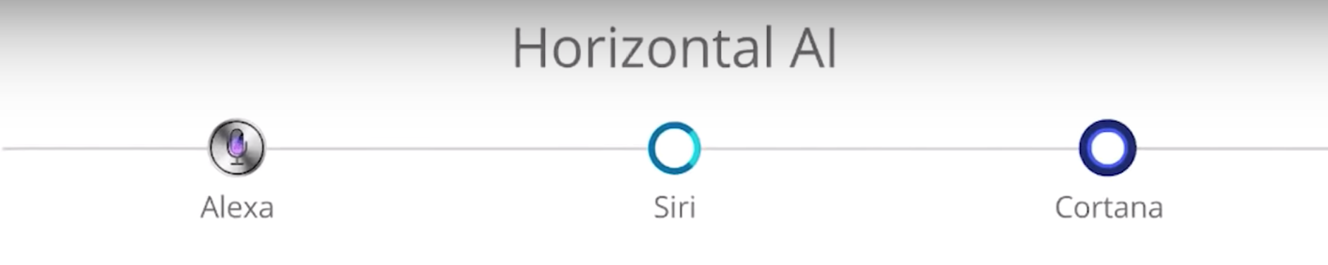
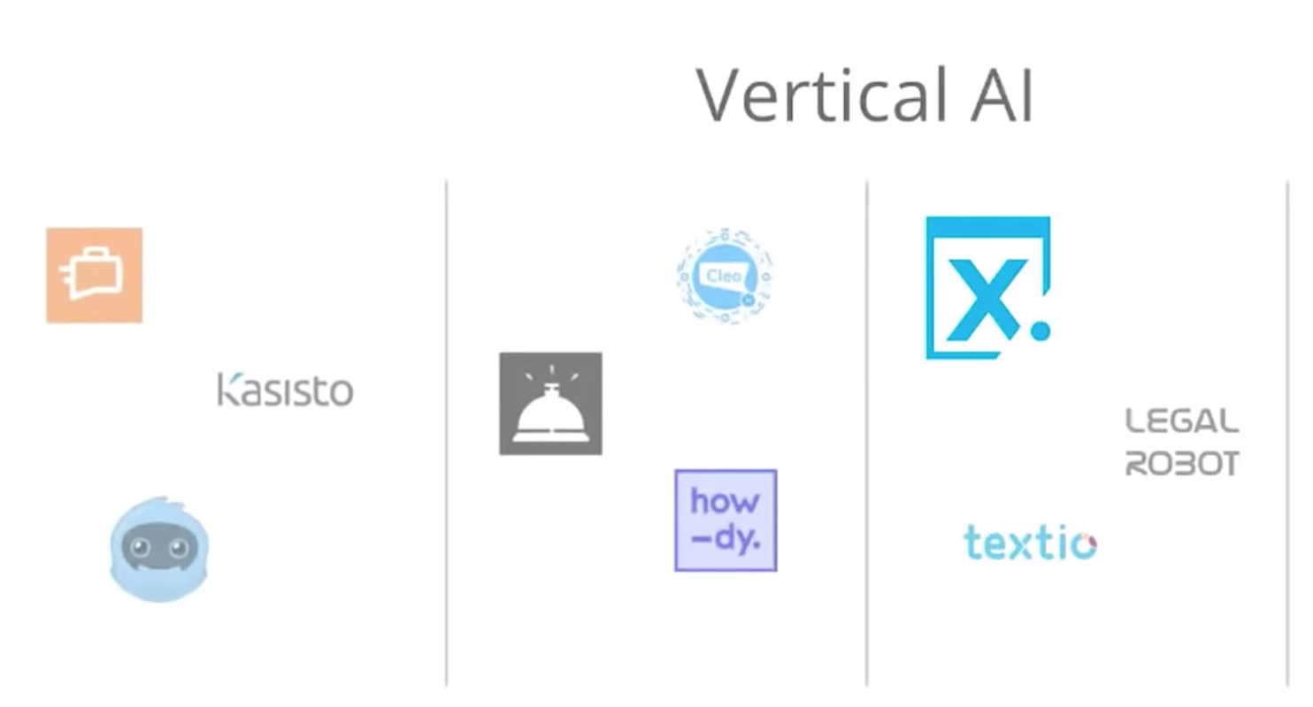

Slide 20
AI-driven development

Slide 21
AI Services
AI-driven development looks at tools, technologies and best practices for embedding AI into applications and using AI
AI infrastructure, AI frameworks ,AI platforms , AI Services
“Technology and thinking will shift to a point where the experience will connect people with hundreds of edge devices”

Slide 22
“By 2020, more than 40% of data science tasks will be automated”
What does it mean to us ?

Slide 23




Build applications that understand people
Intelligence
Vision
Speech
Language
Knowledge
Search
Cognitive Services
Computer Vision
Speaker Recognition
Text Analytics
Academic Knowledge
Bing Search API
Bot Framework
Face
Speech
Bing Speller
Entity Linking Service
Bing Image Search API
Cortana
Emotion
CRIS
Web Language Model
Knowledge Exploration Service
Bing Video Search API
Video
Linguistic Analysis
Recommendations
Bing News Search API
Language Understanding Intelligent Service
Bing Auto Suggest API
Faces, images, emotion recognition and video intelligence
Spoken language processing, speaker recognition, custom speech recognition
Natural language processing, sentiment and topics analysis, spelling errors
Complex tasks processing, knowledge exploration, intelligent recommendations
Bing engine capabilities for Web, Autosuggest, Image, Video and News
Notes:
What’s incredibly unique is the intelligence capabilities Cortana Intelligence offers, building on years of Microsoft research and innovation. These capabilities enable our customers to build intelligent systems and agents that can augment their organizational capabilities. For example, organizations can interact with customers and stakeholders in new ways and infer intent with vision, face, speech, text and sentiment analysis to customize responses and drive appropriate actions.
Microsoft Cognitive Services, a set of cloud services, APIs and SDKs that enable organizations to build intelligent systems that can see, hear, interpret and understand the world around you and makes all applications more intelligent, engaging and discoverable. Cognitive Services expands the existing perceptual intelligence capabilities like Vision, Speech, Text and Face detection to include new cognitive capabilities such as Emotion and customized Language Understanding. What we showcased with www.how-old.net is one example of what is possible.
Why choose these APIs? They work, and it’s easy.
Easy: The APIs are easy to implement because of the simple REST calls. Being REST APIs, there’s a common way to implement and you can get started with all of them for free simply by going to one place, one website, www.microsoft.com/cognitive. (You don’t have to hunt around to different places.)
Flexible: We’ve got a breadth of intelligence and knowledge APIs so developers will be able to find what intelligence feature they need; and importantly, they all work on whatever language, framework, or platform developers choose. So, devs can integrated into their apps—iOS, Android, Windows—using their own tools they know and love (such as python or node.js, etc.).
Tested: Tap into an ever-growing collection of powerful AI algorithms developed by experts. Developers can trust the quality and expertise build into each API by experts in their field from Microsoft’s Research organization, Bing, and Azure machine learning and these capabilities are used across many Microsoft first party products such as Cortana, Bing and Skype.
T: Next, Bot Frameworks.

Slide 24
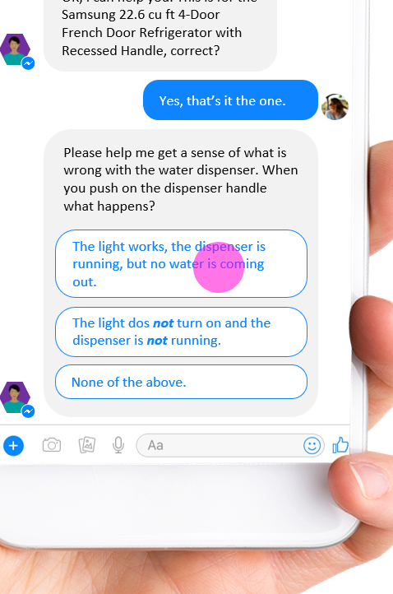
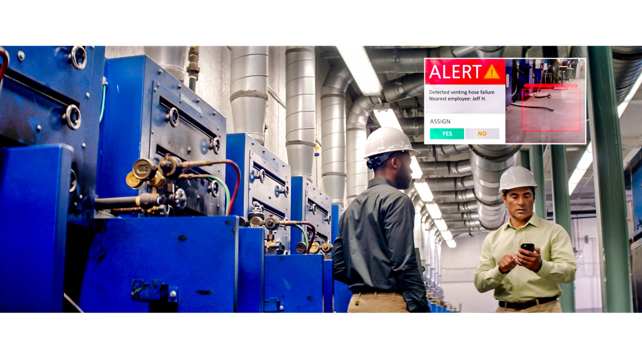
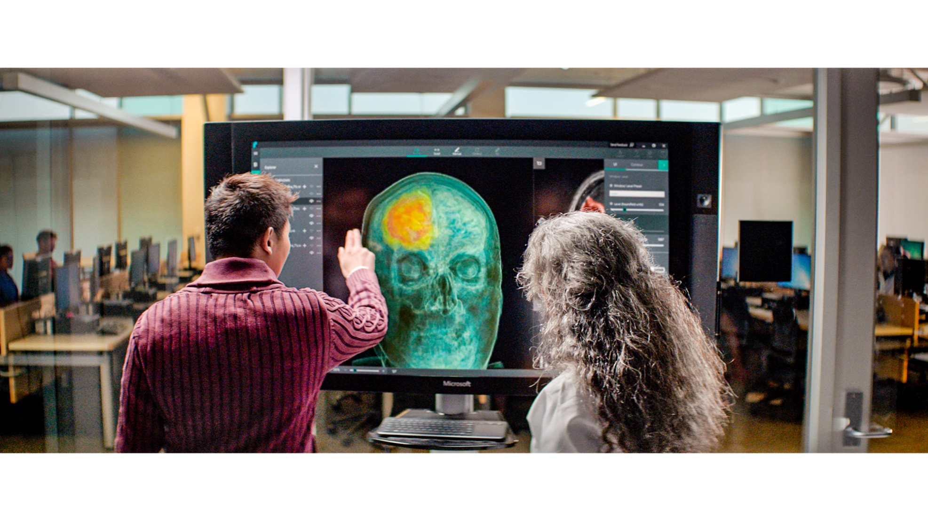


ML/AI is core component of many applications
New generation of business agents
B2B, B2C, B2E
Person, object, and activity detection
Retail, manufacturing, security
AI assisted professionals
Marketing, legal, financial
Knowledge mining
Documents, video
Autonomous systems
Vehicles, networks, RPA

Slide 25
Azure ML Services
Solutions for every possible requirement

Slide 26





Slide 27


























Advanced analytics pattern in Azure
Data collection and understanding, modeling, and deployment
Model training
Serving storage
Sensors and IoT (unstructured)
Azure ML service
Azure ML Studio
ML server
Azure Databricks (Spark ML)
SQL Server (in-database ML)
Data Science VM
Batch AI
Applications
Cosmos DB
Long-term storage
Data processing
Logs, files, and media (unstructured)
SQL DB
Azure Data Lake store
Azure Storage
Cosmos DB
SQL DB
Azure Data Lake Analytics
Azure Databricks
HDInsight
Orchestration
Trained model hosting
SQL DW
Business/custom apps (structured)
Power BI Dashboards
Azure Container Service
SQL Server (in-database ML)
Azure Analysis Services
Azure Data Factory
© Microsoft Corporation

Slide 28
More People Building Machine Learning Models
ML Expert
AML SDK /
Notebooks
No Code
Code First
Auto ML (UX+SDK)
Power BI
No ML

Slide 29

Challenges
Setup development environment
Not familiar with syntax
Manage hardware & infrastructure
Manage scale (training and inference)
Lack of flexibility
Integration with production environment

Slide 30

More People Building Machine Learning Models
ML Expert
AML SDK /
Notebooks
Azure Machine Learning service Visual Interface
No Code
Code First
Auto ML (UX+SDK)
Power BI
No ML

Slide 31
Azure Machine Learning Studio

Slide 32





Azure machine learning studio
A fully-managed cloud service that enables you to easily build, deploy and share predictive analytics solutions
Use Azure Machine Learning to deploy your model into production as a web service in minutes
Work with familiar coding languages such as R and Python while benefitting from hundreds of built-in packages and support for custom code
Deploy models to production as web services that can be called from any device, anywhere, using any data source
Easily share your solution with the world on the Azure Marketplace
© Microsoft Corporation

Slide 33
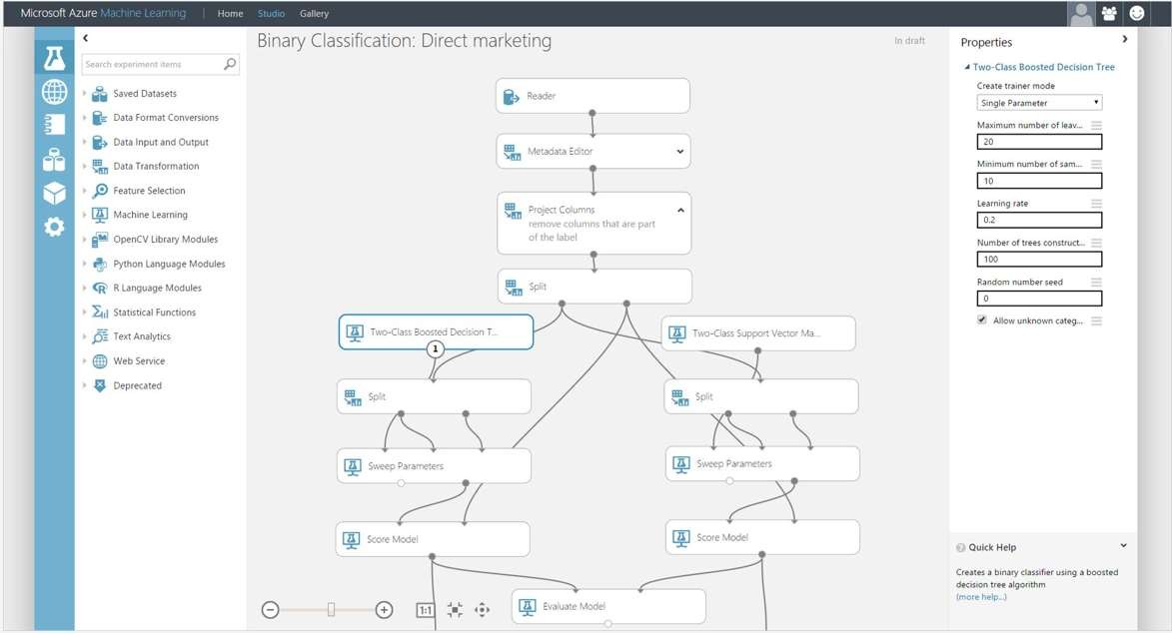
AZURE MACHINE LEARNING STUDIO
Platform for emerging data scientists to graphically build and deploy experiments
Rapid experiment composition
> 100 easily configured modules
for data prep, training, evaluation
Extensibility through R & Python
Serverless training and deployment
Some numbers:
100’s of thousands of deployed models serving billions of requests

Slide 34
What is Machine Learning?

Slide 35





Machine Learning
Machine learning is the subfield of computer science that gives “computers the ability to learn without being explicitly programmed“.

Slide 36
Creating Azure ML Account
Notes:
For a recorded presentation by Azure IoT Program Management through C+E University: IoT Online webinar series: please visit:
https://mspartnerlp.partner.microsoft.com/LearningPath/LearningPath/DLPaths?trackId=2918&rowId=3606&trackPathId=14612

Slide 37
Workflow of Azure ML project/experiment
Notes:
For a recorded presentation by Azure IoT Program Management through C+E University: IoT Online webinar series: please visit:
https://mspartnerlp.partner.microsoft.com/LearningPath/LearningPath/DLPaths?trackId=2918&rowId=3606&trackPathId=14612

Slide 38
Workflow of Azure ML
GET THE DATA
PREPARE THE DATA
FEATURE SELECTION
CHOOSE AND APPLY LEARNING ALGORITHMS
TRAIN AND EVALUATE THE MODEL

Slide 39
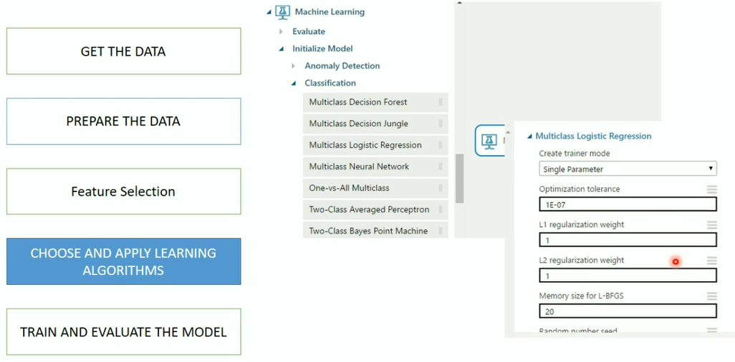
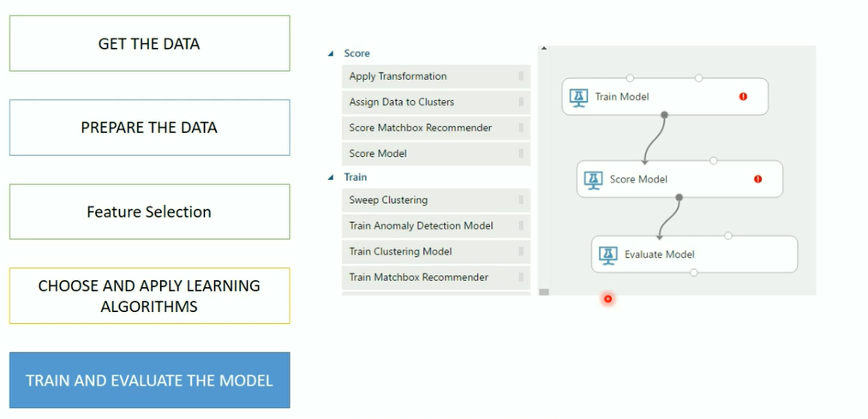
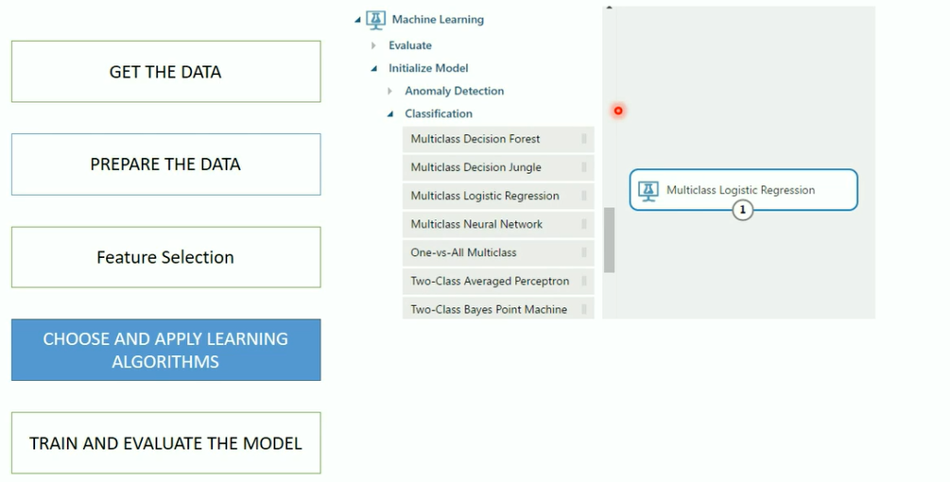
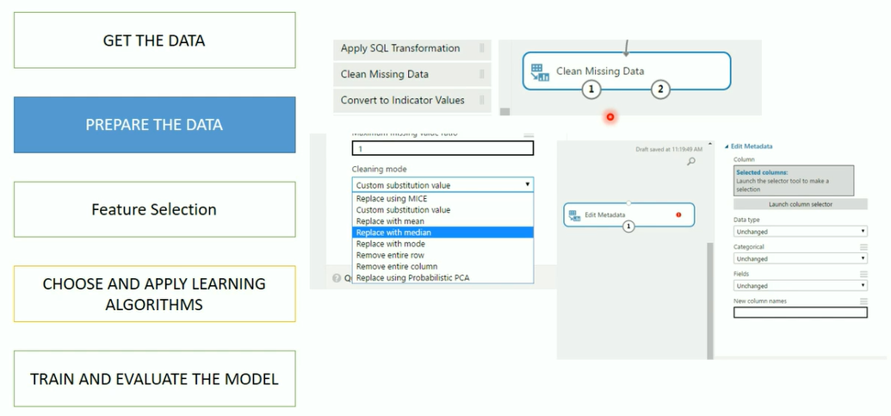
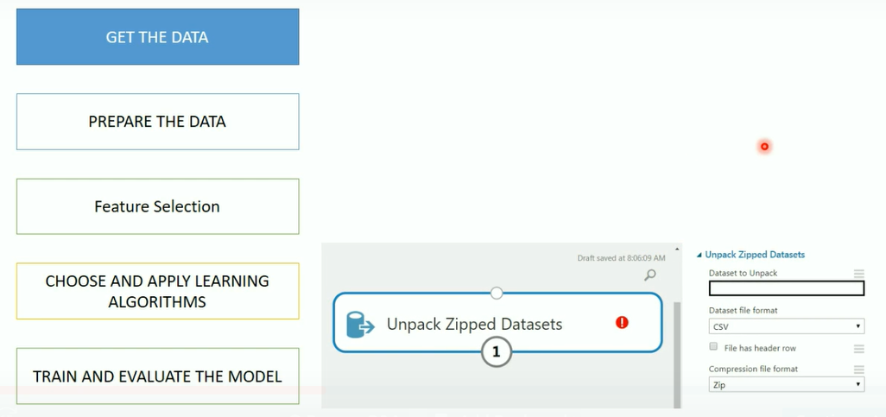
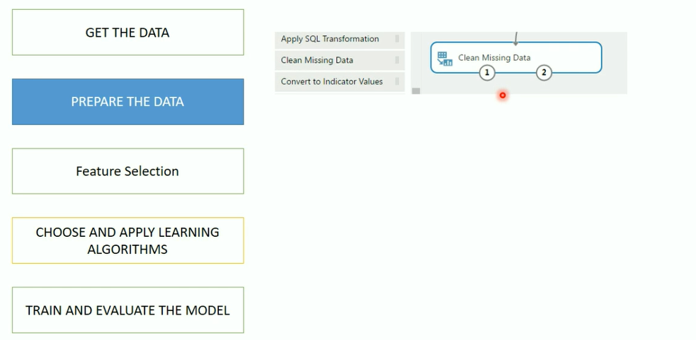
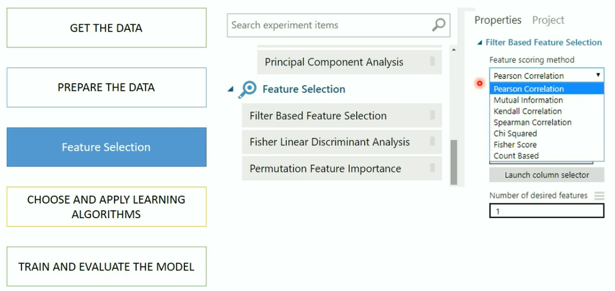
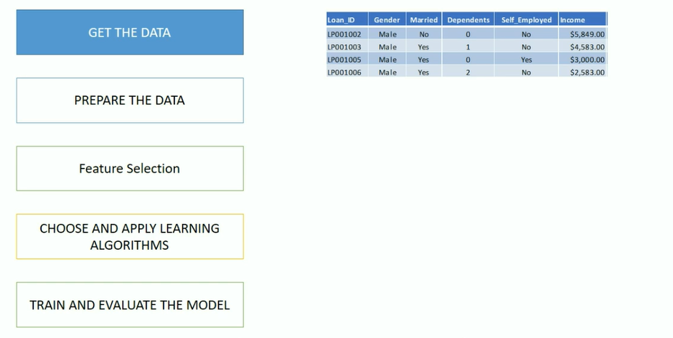
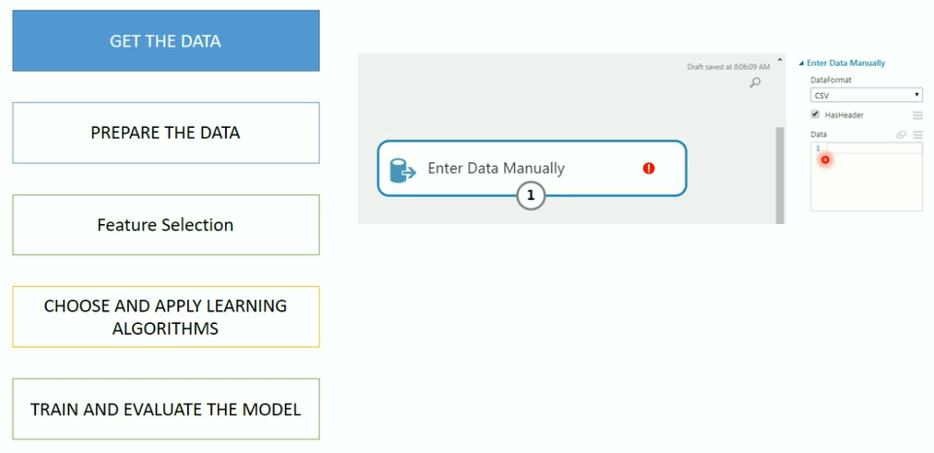
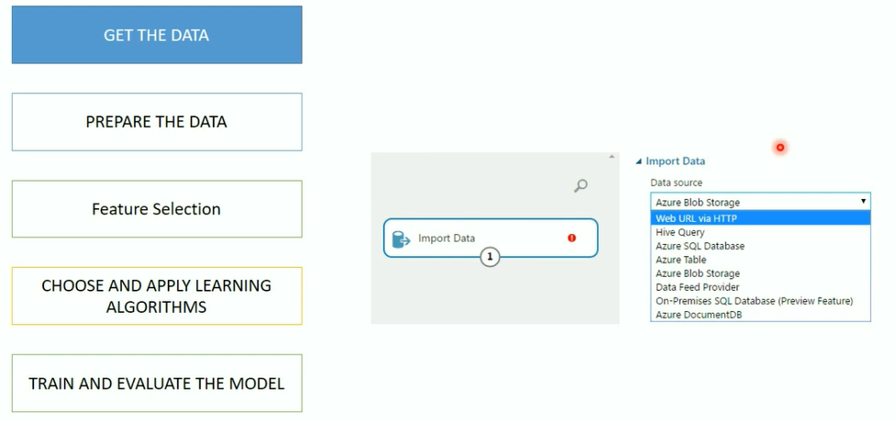
Workflow of Azure ML

Slide 40
Azure ML Algorithm CheatSheet
Notes:
For a recorded presentation by Azure IoT Program Management through C+E University: IoT Online webinar series: please visit:
https://mspartnerlp.partner.microsoft.com/LearningPath/LearningPath/DLPaths?trackId=2918&rowId=3606&trackPathId=14612

Slide 41
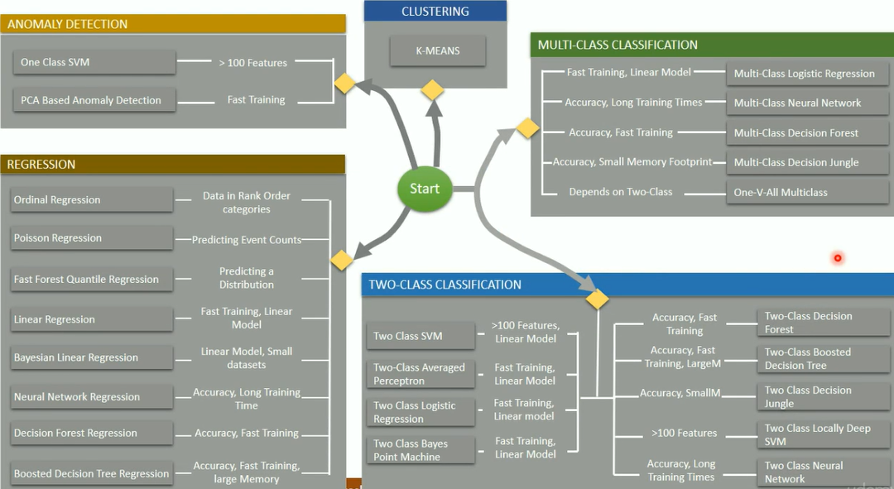

Slide 42
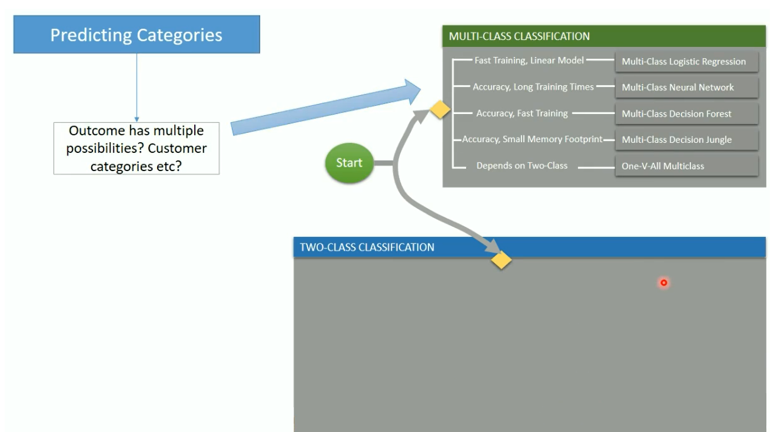
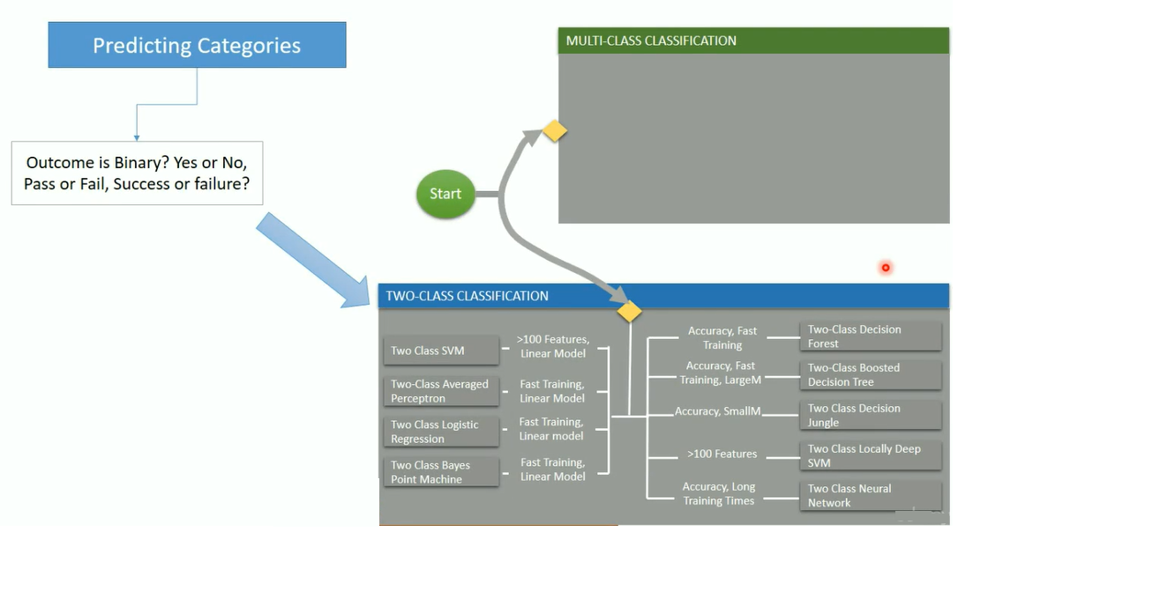

Slide 43
Hands on

Slide 44
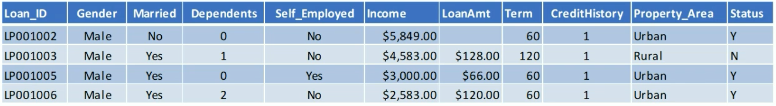
Problem Statement
Automate loan eligibility process
Identify customers whose loan will be approved

Slide 45
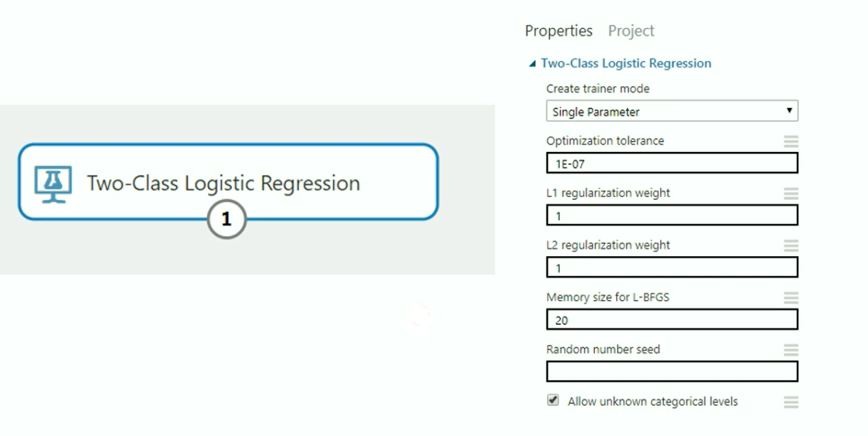
Logistic Regression in Azure ML

Slide 46
What is Logistics Regression?
Used to predict the probability of an outcome
Can be binary - Yes/No or Multiple
Supervised learning method
Must provide a dataset that already contains the outcomes to train the model.

Slide 47
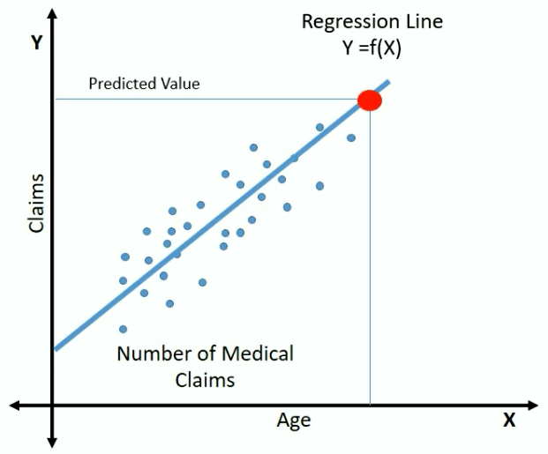
Understanding the Logistic Regression
Y = f(x)
Y = b0 + b1X
No of claims = 18 + b1(age)
Simple Linear Regression

Slide 48
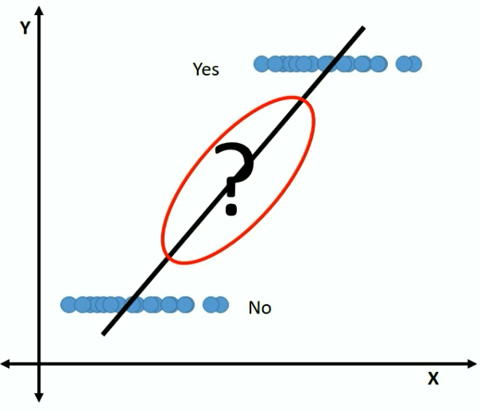
Logistic Regression?
Outcome is categorical
What is the probability of this customer buying
this product?

Slide 49
Logistic Regression?
Probability needs to satisfy two basic conditions
• Always positive i.e. > 0
• Always less than or equal to 1
To make it positive
Y = b0 + b1 X exp(Y) = exp (b0+ b1X)
To make it less than 1 divide it with a number greater than P

Slide 50
Logistic Regression?
exp(Y) = exp ( b0 + b1X)
------------- -------------------
exp(Y) + 1 exp ( b0 + b1X) + 1
e^y
P = ------------- probability of success
e^(y) + 1

Slide 51
Logistic Regression?
e^y
P = ------------- probability of success
e^(y) + 1
e^y e^(y) + 1 – e^y 1
Q = 1 – P = 1 - ----------- = --------------------- = ----------
e^(y) + 1 e^(y)+1 e^(y) +1
Probability of Failure

Slide 52
Logistic Regression?
P
--------- = e^Y
1 – P
P
Log --------- = Y
1 – P
P
Log --------- = b0 + b1X
1 – P

Slide 53
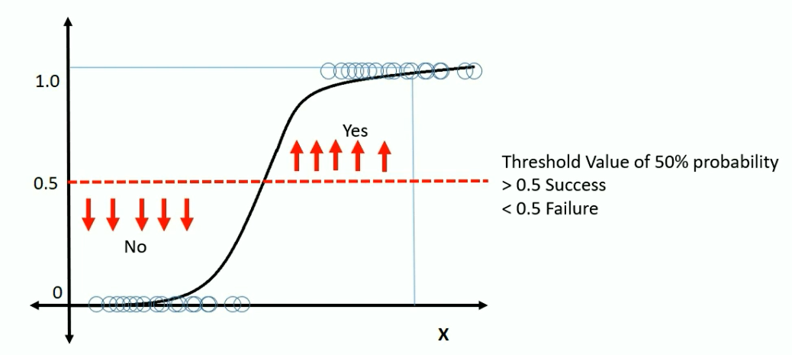
Plotting Logistic Regression?
P
Log --------- = b0 + b1X
1 – P

Slide 54

What are Hyperparameters?

Slide 55
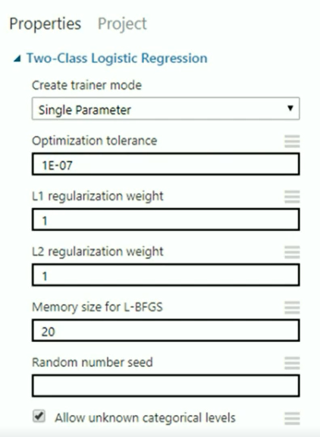
Parameters to Logistic Regression
Create Trainer Mode
• Single Parameter - Provide specific set of values
• Parameter Range - specify multiple values and get the optimum set for given configuration
Optimization Tolerance - Threshold Value to stop the model iterations on trained dataset
Memory Size for L-BFGS - Amount of memory to use for next steps and direction
Random Number Seed - Random integer number that is used for reproducing the same results
Allow Unknown Categorical Levels - Creates an additional "Unknown" level

Slide 56
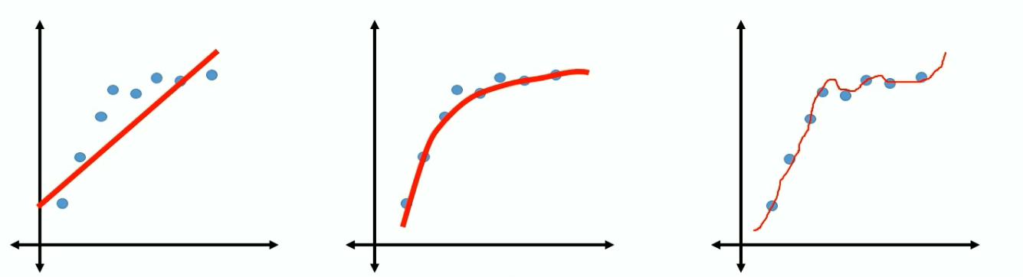
Regularization Weight
b0 + b1X b0 + b1X1 ² b0 + b1X1 ² + b2X2³
Under-fit Right Over Fit
What if the effect of such weights is reduced significantly
Or reduced to zero

Slide 57
Regularization Weight
L2 (Ridge) shrinks all the coefficient by the same proportions but eliminates none
L1(Lasso) can shrink some coefficients to zero, performing variable selection.
Both L1 and L2 regularization prevents overfitting by shrinking (imposing a penalty) on the coefficients.
L2 penalizes one big weight more than many small weights.
With L2, you tend to end up with many small weights, while with L1, you tend to end up with larger weights, but more zeros.

Slide 58
Hands on – Hyper Tuning

Slide 59
What is a Decision Tree?

Slide 60
What is Decision Tree?
Supervised learning method
Decision support tool that uses a tree-like graph or model of decisions and their possible consequences
Various variations such as Boosted Decision Tree, Decision Forest, Decision Jungle
Can be used for categorical as well as continuous variables

Slide 61
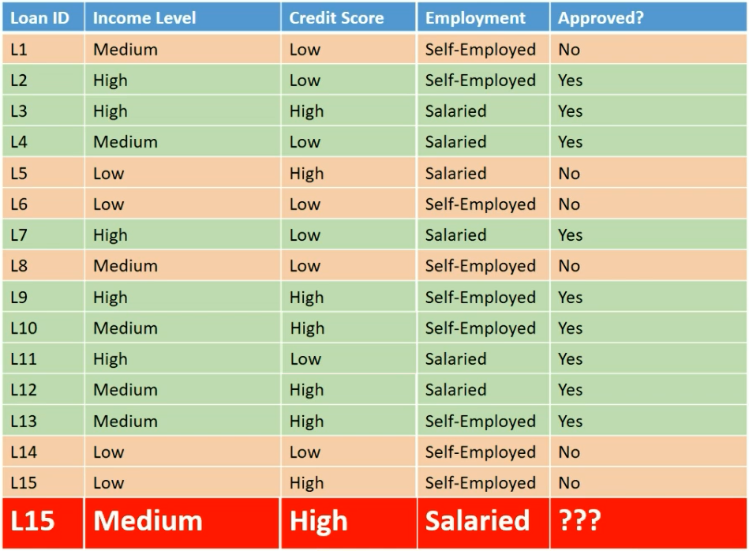

Slide 62
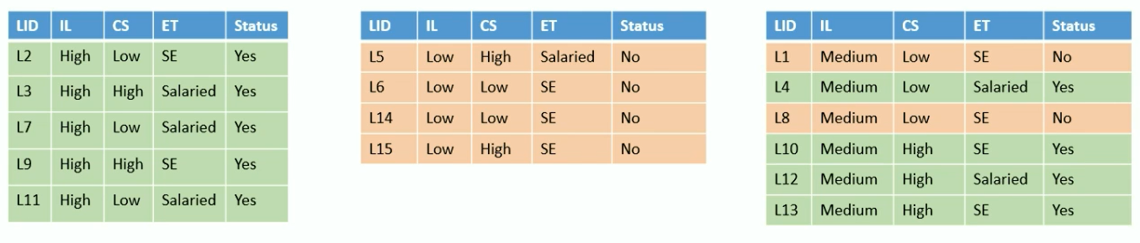
Income
Level
HIGH
LOW
Medium
Pure Subset Pure Subset Split Further

Slide 63
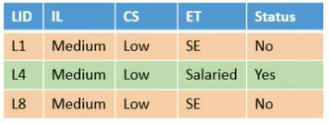
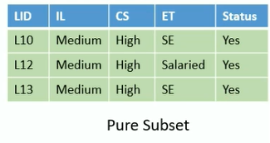
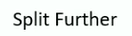
Income
Level
HIGH
LOW
Medium
Credit Score
LOW
HIGH

Slide 64
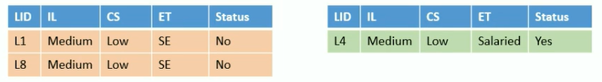
Income
Level
HIGH
LOW
Medium
Credit Score
LOW
HIGH
Employment Type
SE
Salaried
Pure Subset Pure Subset

Slide 65
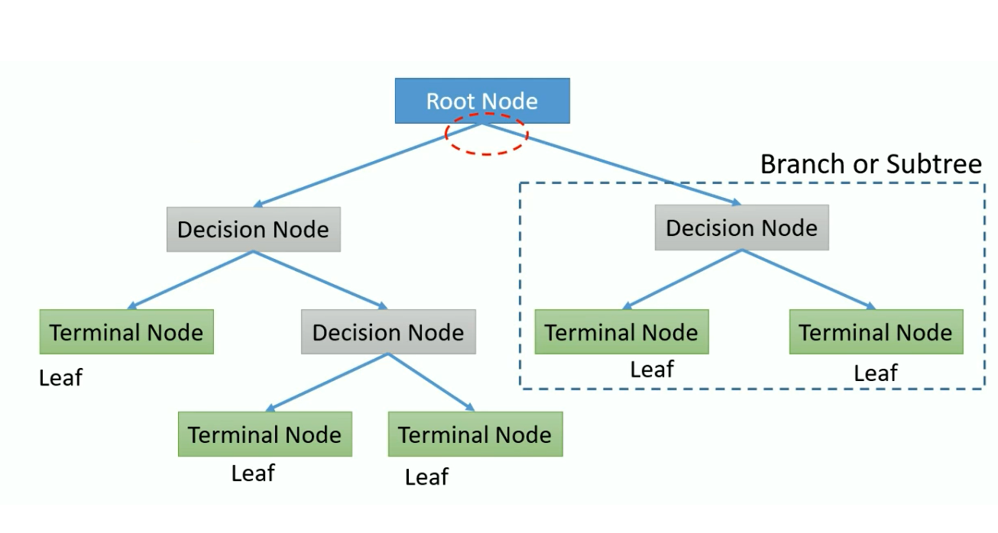
Decision Tree Terms

Slide 66
Ensemble learning

Slide 67
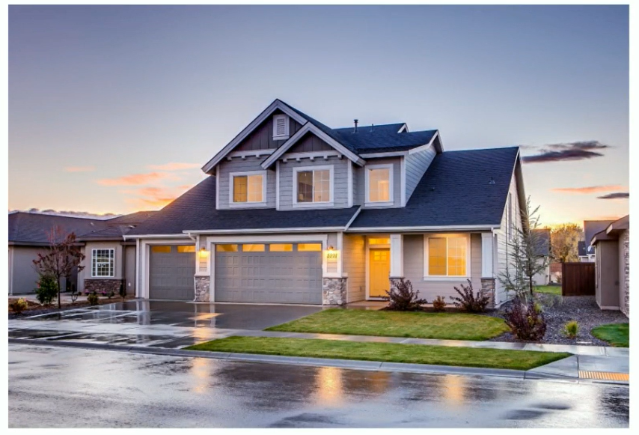
Everyday Ensemble Learning

Slide 68
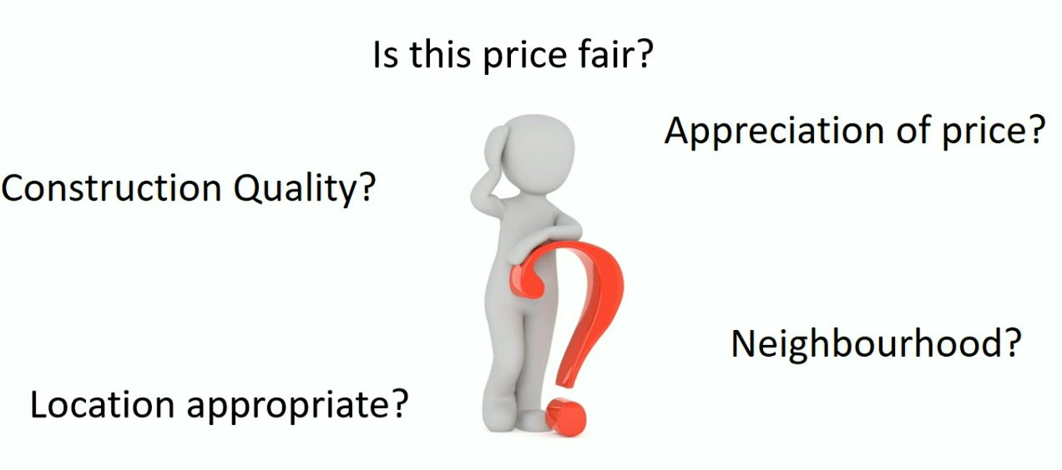
Decision?

Slide 69

Decision?
Broker or real estate portal to check
fair price, price appreciation
Friend or colleague who stays nearby
or stayed in the neighbourhood
Inspection by an architect for quality
checks and structural defects.

Slide 70
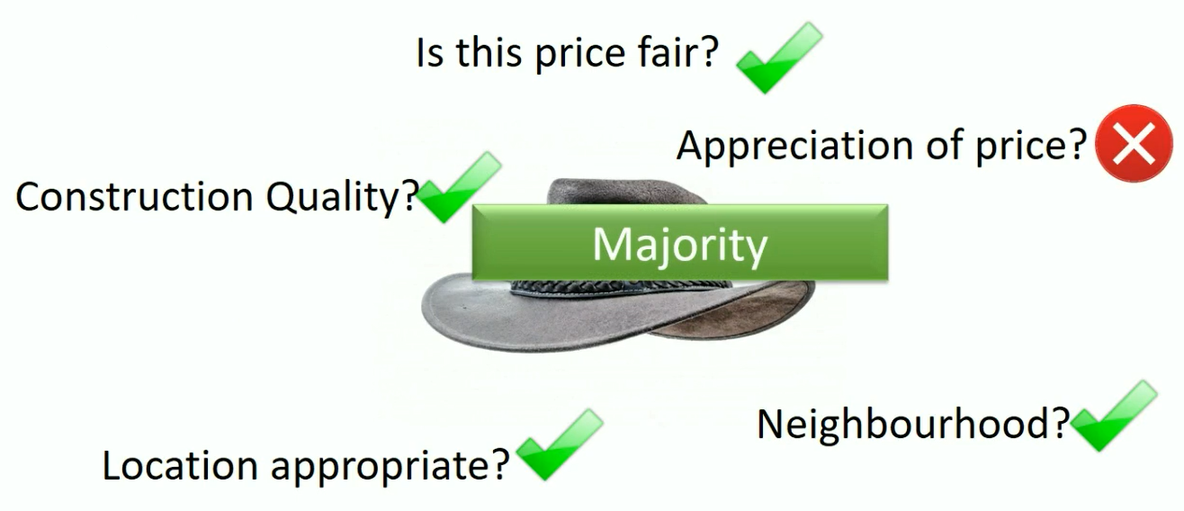
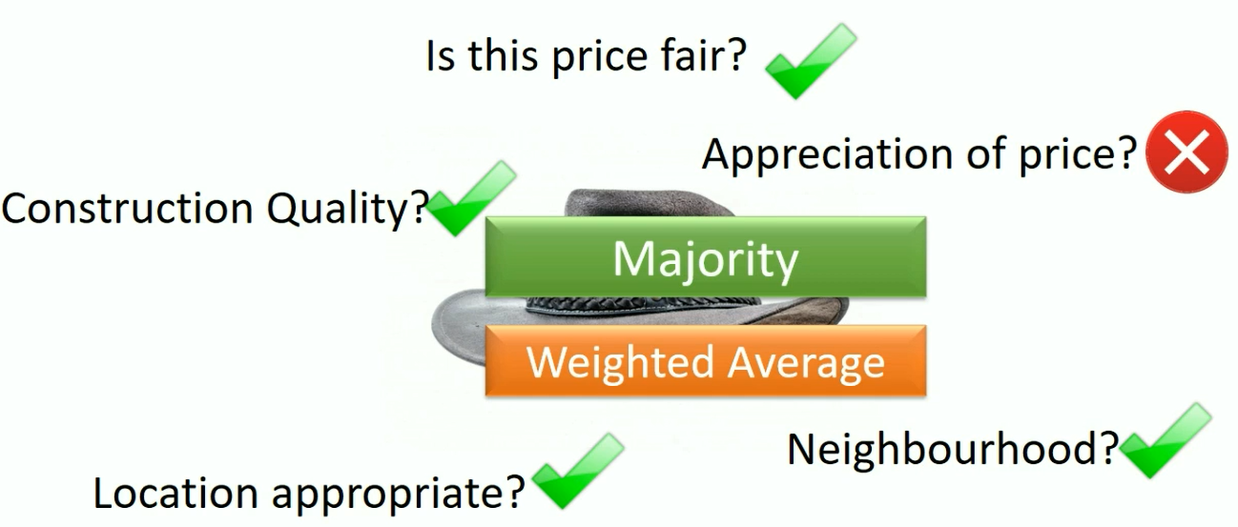

Decision?
Is this price fair?
Appreciation of price?
Construction Quality?
Location appropriate?
Neighbourhood?

Slide 71
Ensemble Learning
All algorithms have errors
Collective wisdom is higher than the individual intelligence
Generate a group of base learners and combined result gives higher accuracy
Different base learners can use different,
Parameters
• Sequence
Training sets etc
Two major Ensemble Learning Methods
• Bagging
• Boosting

Slide 72
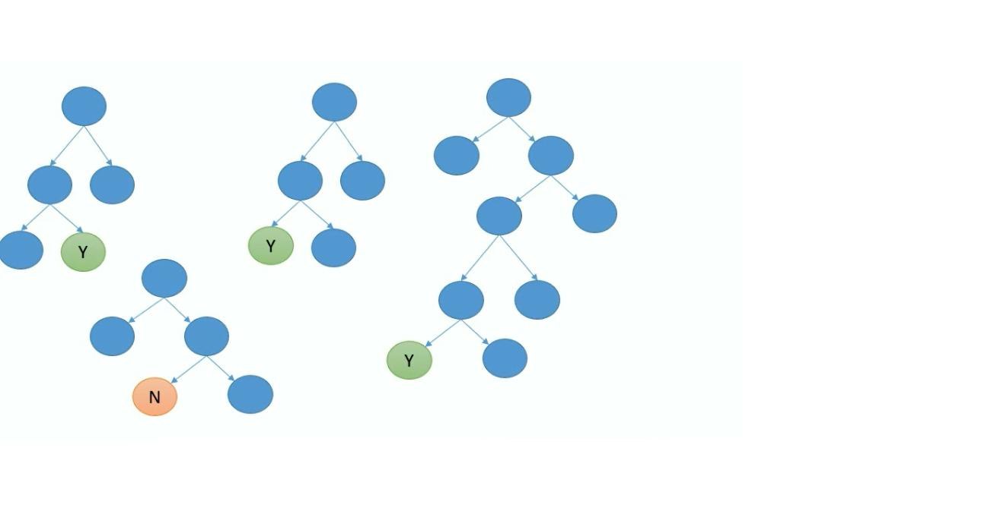

Bagging
Various models are built in parallel
All models vote to give the final prediction

Slide 73
Boosting
Train the Decision Tree in a sequence
Learn from the previous tree by focussing on incorrect observations
Build new model with higher weight for incorrect
observations from previous sequence

Slide 74
Bagging
Various models are built in parallel
All models vote to give the final prediction

Slide 75

Bagging

Slide 76

Adult Census Data
Problem statement: Predict whether income exceeds $50K/yr based on census data
1. Age
2.Workclass
3.Fnlwgt
4.Education
5.Education-Num
6.Marital Status
7. Occupation
8.Relationship
9. Race
10. Sex
11. Capital Gains
12. Capital Losses
13. Hours per week
14. Native Country
15. Income

Slide 77
Hands on – Decision Trees & Deployment

Slide 78
Tune Model Hyperparameters

Slide 79
What are Hyperparameters?

Slide 80
Model parameters?
Decision Trees
Maximum number of leaves per tree
Minimum number of samples per leaf node
Learning rate
Number of trees to construct
Logistic regression
Optimization tolerance
L1 regularization weight
L2 regularization weight
Memory size for L-BFGS

Slide 81
Tune Model Hyperparameters?
Helps in determining the best possible combination of hyperparameters
Also known as hyperparameter optimization
Performance metric to measure
Accuracy
Precision
Recall
AUC
F1Score

Slide 82
Parameter Sweeping Modes
Random Grid
Entire Grid
Random Sweep

Slide 83

What is a Grid?
Cartesian Product of Parameters
Parameter 1→ 1, 2, 3
Parameter 2→ A, B, C, D

Slide 84


Random Grid

Slide 85

Entire Grid

Slide 86
DEMOS

Slide 87
Deploy Models

Slide 88
I have a Model. Now What?
Develop but how to deploy?
Model language is not supported
Difficult to deploy in the current architecture
Tedious Environment set-up
Many more...

Slide 89
Steps for Azure ML webservices Deployment
Creating a Training Experiment
Convert to predictive experiment
Deploy it as a web-service
Consume the web-service

Slide 90
Regression

Slide 91

Regression Analysis
Statistical process for estimating the
relationships among variables
Relationship between a dependent
variable and one or more independent
variables (or 'predictors’)
The predictor is a continuous variable
Can also be used to infer causal
relationships between dependent and
independent variables.

Slide 92

Casual Relationship?

Slide 93


Slide 94
Linear Regression
Simple Regression
Y= B0 + B1X
Multivariate linear regression.
Y= B0 + B1X1 +B2X2 + B3X3……..BnXn

Slide 95
Simple Linear Regression

Slide 96

Simple Linear Regression
Simple Regression
Y = b0 + b1X
Dependent Variable Independent Variable

Slide 97



Simple Linear Regression

Slide 98



Simple Linear Regression

Slide 99

https://gallery.azure.ai/

Slide 100
Data Science Virtual Machines (DSVM)

Slide 101


Data Science Virtual Machines

Slide 102



Slide 103


Slide 104




Why Data Science VMs?
Elastic analytics desktop in the cloud
Get started quickly on Azure Machine Learning
Pre-setup environment at work and school
Enterprise Ready and globally available

Slide 105



Productive Services Empower data science and development teams
Integrated data science & data engineering teams
Desktop solutions not adequate
Need a unified big data & machine learning solution
Individual data scientists
Desktop solutions adequate
Need cloud for sporadic compute needs
+
Azure Databricks
Azure Machine Learning service
Machine Learning VMs
Notes:
We realize that companies are at different stages of building data science teams.
From a sales perspective, we would like you to focus on companies that are building end to end big data and machine learning solutions as this where you will drive maximum amount of Azure consumption.
For these customers, we recommend starting with Azure Databricks and enhancing the ML experience with Azure Machine Learning.
Now we also realize that a good number of projects that are not done on big data or by big integrated teams.
For these customers, we have a set of Machine Learning VMs that are pre-provisioned with popular open source tools and packages. These are essentially desktops in the cloud that enable data scientists to quickly get up and running for their projects.
Let’s look at how we use Azure Databricks and Azure ML together.

Slide 106
Azure Machine Learning service

Slide 107
WHAT IS AZURE MACHINE LEARNING SERVICE?
Set of Azure Cloud
Services
Python SDK
That enables you to:
Prepare Data
Build Models
Train Models
Manage Models
Track Experiments
Deploy Models

Slide 108










Custom AI
Typical E2E Process
Prepare
Experiment
Operationalize/Deploy
…
Data Science Virtual Machine Azure Databricks
Machine Learning Compute
Azure Container Instances Azure Kubernetes Service
Azure Data Factory
Azure Databricks
Azure ML service
Orchestrate

Slide 109

Azure ML Concept
Model Management
Model Management in Azure ML usually involves these four steps
Step 1:
Step 2:
Step 3:
Step 4:

Slide 110
Azure ML Artifact
Compute Target
Currently supported compute targets
Compute Target | Training | Deployment
Local Computer | ✓
A Linux VM in Azure (such as the Data Science Virtual Machine) | ✓
Azure ML Compute | ✓
Azure Databricks | ✓
Azure Data Lake Analytics | ✓
Apache Spark for HDInsight | ✓
Azure Container Instance |  | ✓
Azure Kubernetes Service |  | ✓
Azure IoT Edge |  | ✓
Field-programmable gate array (FPGA) |  | ✓

Slide 111





Azure ML Artifact
Deployment
Deployment is an instantiation of an image. Two options:
Web service
IoT Module

Slide 112

Services
Customer journey
Data Prep
Build and Train
Manage and Deploy
Python ML developer
Azure ML service
(OSS frameworks, Hyperdrive, Pipelines, Automated ML, Model Registry)
Azure ML service
(containerize, deploy, inference and monitor)
Azure ML service
(Pandas, NumPy etc. on AML Compute)
+
Apache Spark / Big Data
Azure Databricks
(Apache Spark Dataframes, Datasets, Delta, etc.)
Azure Databricks + Azure ML service
(Spark MLib and OSS frameworks +
Automated ML, Model Registry)
Azure ML service
(containerize, deploy, inference and monitor)

Slide 113
Comparable Table
 | Azure Machine Learning Studio | Azure Machine Learning Services
Pros | Rapid development (Drag and Drop) Works well with relatively simple datasets Pre-built ML algorithms Cheap | Fast (VMs with GPUs) Different optimization methods, CI/CD pipeline Full control during training Manage computing resources (choose VM size) Use open source ML libraries
Cons | Can be slow Limited optimization methods, operationalized architecture Less control during training Fixed computing resources | More elaborate to build, require deeper knowledge of machine learning Deeper models need much more data with much more memory Higher costs for VM with GPU

Slide 114
Demo –Deployment

Slide 115
Demo – Hyper Tuning Parameters

Slide 116
Automated Machine Learning
(in Machine Learning Services)

Slide 117


What is automated machine learning?

Slide 118

AutoML
© Microsoft Corporation

Slide 119


Machine Learning Process
SQL DB
Cosmos DB
Datawarehouse
Data lake
Blob storage
…
Prepare Data
Build & Train
Deploy

Slide 120
Machine Learning Problem Example
How much is this car worth?

Slide 121
Model Creation Is Typically Time-Consuming
Which features?
Which algorithm?
Which parameters?
Mileage
Condition
Car brand
Year of make
Regulations
…
Gradient Boosted
Nearest Neighbors
SVM
Bayesian Regression
LGBM
…
Parameter 1
Parameter 2
Parameter 3
Parameter 4
…
Mileage
Gradient Boosted
Condition
Nearest Neighbors
Car brand
Car brand
50%
Year of make
30%
Year of make
Model
Iterate

Slide 122

Machine Learning Complexity
Source: http://scikit-learn.org/stable/tutorial/machine_learning_map/index.html

Slide 123

Model Selection & Hyperparameter Tuning
Dataset
Model Training
Infrastructure
Training Algorithm 1
Training Algorithm 2
Model 1
Model 2
Model 3
Model 4
Hyperparameter
Values – config 1
Hyperparameter
Values – config 2
Hyperparameter
Values – config 3
Repetitive & Manual
Hyperparameter
Values – config 4

Slide 124
Introducing Automated Machine Learning
Dataset
Optimization
Metric
Automated ML
ML Model
Constraints
(Time/Cost)
Accessible & Faster

Slide 125

Automated ML Capabilities
Based on Microsoft Research
Brain trained with several million experiments
Collaborative filtering and Bayesian optimization
Privacy preserving: No need to “see” the data

Slide 126
Automated ML Capabilities
ML Scenarios: Classification & Regression
Integration: Azure Machine Learning, Azure Notebooks, Jupyter Notebooks
Data Type: Numeric, Text
Languages: Python SDK for deployment and hosting for inference
Training Compute: Local Machine, Remote Azure DSVM (Linux), Azure Batch AI
Transparency: View run history, model metrics
Scale: Faster model training using multiple cores and parallel experiments

Slide 127












Azure Automated ML
Current Capabilities
 | Category | Value
Compute Target

Slide 128
Web UI [Azure portal - Preview]
Create automated ML experiments from UI only (“no code”)
Get started with ML quickly
Powered by the automated ML SDK – easily customize advanced settings
Automate the end-to-end ML workflow from the UI
Easily explore and monitor all your experiments from a single place
Roadmap
Private Preview - 2/11
Getting started experience
Start an automated ml training job on your data (upload/Blob)
Explore data
View progress and results for training job and each iteration
View automated ML dashboard for an overview
May 2019 – General Availability
Apply data transformations
Support additional 1p & 3p data source
Continue experiment in Jupyter Notebook
Public Preview - April 2019
Set advanced settings for the training job
Forecasting support
Automatically deploy a model
Advanced data exploration (visualizations, correlations, etc.)
View model Explainability
Support additional 1p data sources (e.g. Azure SQL, ADLS, …)
Microsoft confidential (NDA)

Slide 129



“Day 0” (First time) experience
Create your first experiment with automated machine learning to produce quality models with zero effort
Automate the process of algorithm selection, hyperparameter tuning, and best model selection with automated machine learning, and accelerate your productivity. Select your data and let automated ML do the rest to provide the best model from endless possible options

Slide 130


Create a new automated machine learning experiment
* Experiment name
myfirstautomlexperiment
* Training compute 
amlcompute-4a57de20b3f1
Create new
Cancel
Next

Slide 131




Create a new automated machine learning experiment
* Experiment name
myfirstautomlexperiment
* Training compute 
Select existing…
Create new
Select a file from Azure blob storage account
* Storage account
mytestmlexperimentsto…
* Container
automl-blob-d8b2d4df-…
Select a sto ner to view the files list
rage account and a contai
Data Preview
Data Profile
Use first row as header
Include in training
Include in training
Include in training
Include in training
Include in training
Include in training
Include in training
Include in training

Slide 132



Data Preview
Data Profile
Include in training
Include in training
Include in training
Include in training
Include in training
Include in training
Include in training
Include in training
Training job settings:
* Training job type 
Classification
* Target column 
Freight cost
* Primary metric 
Accuracy
Number of iterations:
100

Slide 133


Data Preview
Data Profile
Data Preview
Data Profile
Condensed view
Include in training Include in training Include in training Include in training Include in training Include in training
Include in training Include in training
Training job settings:
* Training job type 
Classification
* Target column 
Freight cost
* Primary metric 
Accuracy
Number of iterations:
100

Slide 134


Training job settings:
* Training job type 
Classification
* Target column 
Freight cost
* Primary metric 
Accuracy
Number of iterations:
100
Cancel
Start

Slide 135





Myfirstautomlexperiment | Run #XXX

Slide 136






















“Day 30” experience
Automated machine learning dashboard
All dates
#
Running
#
Completed
Run status history (All)
15
Cancelled
10
Failed
5
Completed
#
Failed
#
Cancelled
0
Running

Slide 137
Demo

Slide 138
Build 2019

Slide 139




Authoring Experiences in Azure Machine Learning
Automated
Machine Learning
Visual Interface
Notebooks

Slide 140
Authoring Experiences in Azure Machine Learning
Automated
Machine Learning
Visual Interface
Visual Interface
Notebooks

Slide 141

Visual Interface for Azure Machine Learning service (Public Preview)
Visual workflow to build, test, and deploy ML models more easily and efficiently

Slide 142

Who to Use
New to Machine Learning
Novice Data Scientists
ML Experts
Learn machine learning
Build model and prefer visual tool than coding
Quick prototype

Slide 143

Visual Interface
Drag-n-drop
Built-in modules
Data visualization
Model evaluation

Slide 144


Best from AML service
Bring your own compute
Scale align with data growth or model complexity
Auto cool down for saving cost
Deploy to your own environment
Run history & versioning
Debuggability

Slide 145




Fully Integrated with AML Service
Computes
Experiments
Models
Web Services
Visual Interface

Slide 146




Fully Integrated with AML Service
Computes
Experiments
Models
Web Services
AML Service on Azure Portal

Slide 147

Easy Deployment
A few clicks
Automatic generate scoring file
Model registration
Build image
AKS for scale

Slide 148

Custom Code
Run Python code
Create Model
Placeholder

Slide 149
Building blocks for a Data Science Project
Build and train models
Hyperparameter tuning
Experimentation and pipelines
Deployment
DevOps for data science
Classical ML
Data sources
Deep learning
Notes:
Let’s first talk about about building blocks of a Data Science Project. Agree on terminology.
Example of Classical ML algorithm
A model parameter is a configuration variable that is internal to the model and whose value can be estimated from data.
A model hyperparameter is a configuration that is external to the model and whose value cannot be estimated from data.
Experimentation and pipelines?
Deployment. What could be a deployment target?

Slide 150








Machine Learning on Azure
Domain Specific Pretrained Models
To reduce time to market
…
Vision
Speech
Language
Search
Familiar Data Science Tools
To simplify model development
PyCharm
Jupyter
Visual Studio Code
Command line
Popular Frameworks
To build machine learning and deep learning solutions
PyTorch
TensorFlow
Scikit-Learn
ONNX
Productive Services
To empower data science and development teams
Azure Databricks
Azure Machine Learning
Machine Learning VMs
Powerful Hardware
To accelerate deep learning
CPU
GPU
FPGA
From the Intelligent Cloud to the Intelligent Edge
Notes:
Distinguish between prebuilt and custom ai.

Slide 151
Power BI AutoML

Slide 152


Slide 153


